Slide 1


Langton Primary School Collaboration with Foston, Stillington & Terrington Federation

Slide 2
Agenda
Recent closures
Challenges for small schools
Options for small schools
Benefits for our children
- curriculum leadership
- quality of education
- opportunities
- peer groups
- finances
Questions

Slide 3
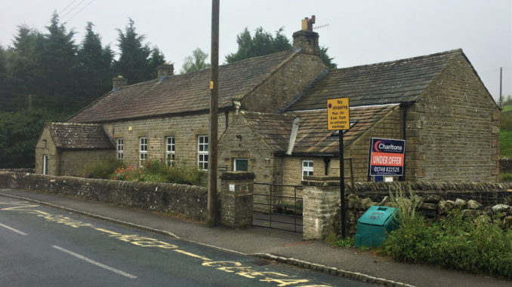
https://www.richmondshiretoday.co.uk/bleak-future-forecast-for-small-rural-schools-in-north-yorkshire/
The succession of rural primary school closures across England’s largest county are “only likely to get worse” Andrew Smith, the Diocese of York’s director of education

Slide 4
16 primary schools have closed in the past six years.
Councillors heard financial pressures on the county’s smaller schools was rising, and the number of primary school age pupils was set to fall in every area of the county except the Selby area and Craven.
As many small rural schools struggled to balance the books, governors and headteachers were forced to make cutbacks and decisions.
…it is only likely to get worse because of where the financial projections are going it is likely we are going to face more school closures.
The council was examining how it could encourage schools to work together to create “strength in numbers”

Slide 5


The current economic climate is creating significant challenges for all schools, and small schools in particular, are facing difficult times.
Federation / Collaboration is one way in which small schools, through sharing resources, enhancing leadership, and spreading costs can ensure their continuing viability whilst maintaining their individuality.
School budgets are based on pupil numbers. Costs are rising whilst pupil numbers are forecast to drop in the coming years.
Recruitment of Headteachers and teaching staff for small, rural schools is becoming increasingly difficult.
As budgets become tighter, support staff will be the first to feel the effect and in turn your children will have less support.

Slide 6
Current staffing structure:
Headteacher – Strategic decisions, School improvement, Day to day running of the school, Teaching and learning, assessment, behaviour, , curriculum monitoring, training, performance management, DSL, Senco, English lead, PSHE lead, governor, Maintenance & repairs.
School business Manager – Admin, parental liaison, day to day finance, bookings – trips, course, visitors…, wraparound care, health & safety, HR, first aid, ordering.
Senior teacher – DDSL, Maths lead, PE lead, ECT mentor, governor, classteacher.
Teacher – Computing lead, French lead, RE lead, trainee mentor, classteacher.
Teacher – Science lead, Music lead, KS1 lead, classteacher.
Teacher – Early reading & phonics lead, EYFS lead, classteacher.
(2x Part-time teachers – History, Geography, Art, DT lead, Enrichment, School Council)
Support staff – Library, Healthy Schools, Pastoral, Dinner duty, break duty, first aid, intervention groups.

Slide 7
For some time now the governing body has been considering the way forward for Langton Primary School.
Options:
- Remain as a standalone primary school
- Academize or join a MAT
- Collaboration / Federation

Slide 8
Langton school has previously enjoyed a good working relationship with the FST Federation, collaborating on inter school moderation, and sharing ideas on school leadership best practice. Their culture and ethos are well aligned with Langton’s and they have demonstrated success in making collaboration between small schools work to the benefit of all parties. Geographical proximity will also be helpful in terms of some of the practical aspects of working together.

Slide 9
Our vision is for Langton to be an excellent school, where outstanding practice and a nurturing ethos enable every child to thrive.
Our Mission
To achieve our vision, pupils, parents, staff and governors work in partnership to provide a safe and sustainable learning environment, delivering excellence and equality for all. Children develop their independence and resilience and are prepared well for the future through the provision of a creative curriculum and a wide variety of extra-curricular opportunities.
The Values which underpin our mission are:
Excellence, Respect, Nurture, Creativity, Collaboration, Resilience
At Terrington, part of the FST Federation, our commitment to promoting sustainability, affirming diversity, embracing community and inspiring creativity. Our core Fruit of the Spirit values of love, joy, patience and self-control are rooted in the words of St Paul (Galatians 5 v 22-23). These Christian values are fostered in the pupils and staff building an ethos where all can flourish.

Slide 10
Head of School, DSL, School Improvement Lead
Head of School, DSL, School Improvement Lead
Business manager - Finance
Business manager - Finance
Senior Admin Officer – HR, Health & Safety, Safeguarding
Pastoral Lead
Senco Team
Senior Teacher
Maths Lead
Senior Teacher English Lead
Senior Teacher
Science Lead
Senior teacher
EYFS Lead
Teachers – dedicated subject leads for each subject
Support staff – Classroom support and Interventions

Slide 11
Leadership
Strategy | Impact on children
Executive Head focused on strategic development | Tailored curriculum, strong vision and values, better quality of education
Heads of schools with primary focus on day to day school effectiveness | Strong, up to date, constantly developing teachers who teach extremely effective sessions
Dedicated pastoral lead | Dedicated person to deal with child protection issues, vulnerable families, attendance
Business manager and Senior office staff | Support for finance, health and safety, safeguarding administration ensures school leads are focusing on progress of children and school improvement
Wider leadership team and middle management | Effective career progression opportunities ensure retention of staff is strong allowing continuity of school improvement
Head of schools structure | More visible and accessible leadership to improve parental involvement

Slide 12
Curriculum
Strategy | Impact on children
Dedicated Curriculum Team | Research based tailored curriculum that suits our schools and allows children progression through all subjects in a coherent and logical way ensuring strong progress for all children
Dedicated subject leaders who focus on one subject across the schools | Specialist and passionate teachers support and develop a curriculum area across the schools to ensure best opportunities for our pupils
Phase staff teams across age groups | Shared planning of the curriculum areas ensure well thought out and resourced planning for all subjects, reduced workload for teachers, wider skills base to draw from to improve teaching
Curriculum Enhancements | Wider phase teams and dedicated subject leaders maximises the time to plan to bring our curriculum alive through trips, visitors and experiences for our children
Assessment Lead / SENCO | Children’s progress is carefully tracked and early intervention implemented to ensure good progress for all children
Dedicated PE lead and sports coaches | Children experience varied and extensive sporting opportunities that go beyond the national curriculum expectations

Slide 13
Peer groups / Opportunities
Strategy | Impact on children
Wider peer groups across our schools | Increased confidence, more friends when children move to secondary school
Phase teams of teachers working together | Curriculum enhancements including trips and visitors bring our curriculum alive
Specialist teachers | Our curriculum offer is widened for our children

Slide 14
Impact on children
Maintain class sizes to ensure best opportunities for children
Maintain teaching assistant support to improve progress for children
Delegated leadership to allow for effective focused school improvement
Sustainability of small rural schools for families within locality
Attractiveness to academies should the government insist on this again
Improved resources and opportunities for children
Specialist teachers in music and PE are affordable
Full wrap around care is affordable alongside subsidised after school enhancements
Joint purchasing of resources, services, training

Slide 15


